Slide 1
Digital Twin for Pandemic Simulation and Health Prediction
by: K.S.Abhihkeshav (21CSB0F03)

Slide 2
Table of Contents
Problem statement
Introduction
Methodologies
Implementation
Demo
Limitations
Conclusion

Slide 3
Problem Statement
To accurately simulate the spread of pandemics and predict individual health outcomes by leveraging lightweight, AI-driven models within a Digital Twin framework for run-time analysis and decision-making.

Slide 4
Introduction
Pandemics like COVID-19 have underscored the urgent need for agile, data-driven decision-making tools in public health.
Simulating pandemic situations is essential for optimizing resource allocation and minimizing the impact of disease outbreaks when they occur. It plays a critical role in disaster management planning.
In the context of healthcare and pandemics, a digital twin can represent individual patients, populations, or entire healthcare infrastructures simulating their behaviours and responses under varying conditions.
The core idea behind a digital twin involves a continuous data exchange between the physical and virtual worlds enabling simulation and prediction.

Slide 5
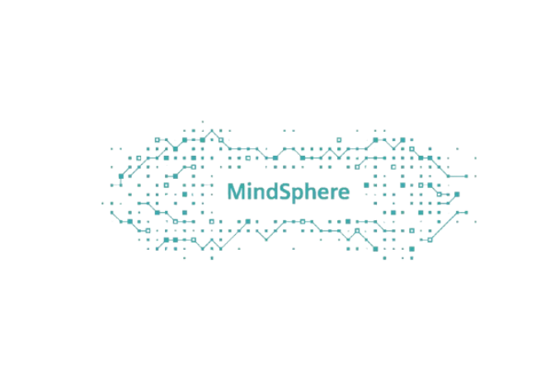
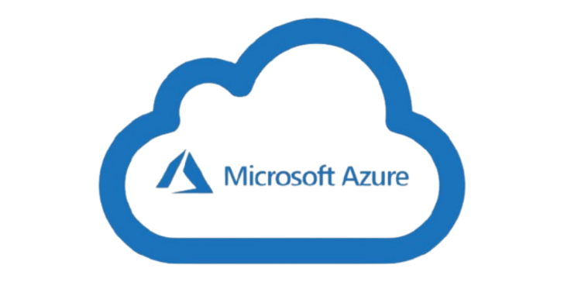
Methodologies
Existing models for pandemic simulation have utilized various digital twin platforms such as Microsoft Azure Digital Twins, Siemens MindSphere, and AnyLogic.
Some implementations have taken a highly realistic approach, while other models prioritize computational efficiency and abstraction depicting people as simple blobs and homes as static geometric shape.
Some models rely on continuous data from IoT-enabled devices such as heart rate monitors and wearable activity sensors.
Other models present only the statistical data and do not show any visualization for pandemic and health monitoring.

Slide 6
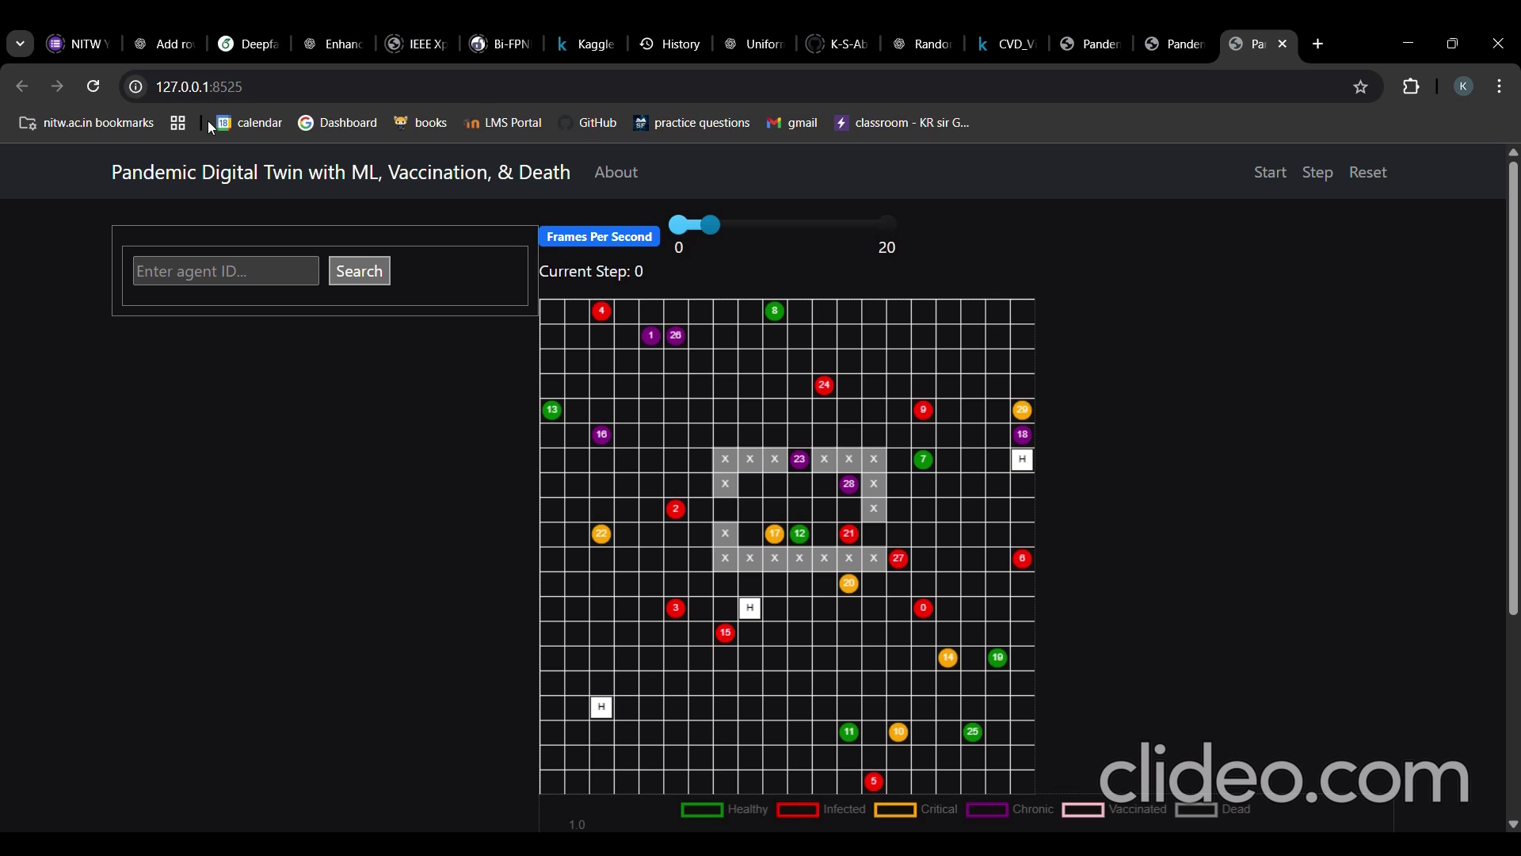
Demo

Slide 7
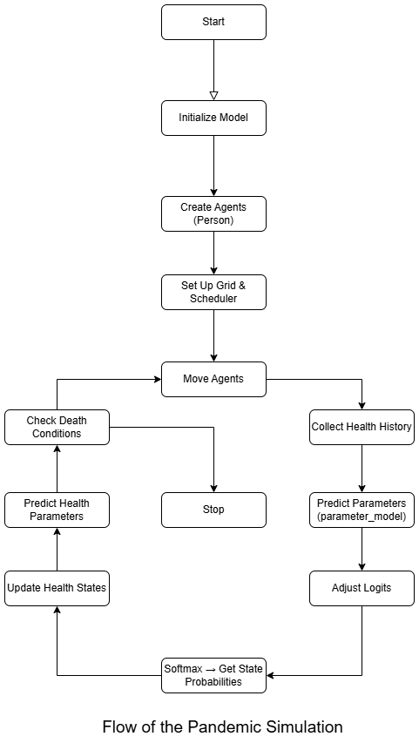
Implementation - I
The proposed solution is implemented using the Mesa 1.2.0 Python framework.
It involves the visualization of the environment to be a grid with the people as blobs, hospitals scattered in the area and other landmarks.
ML algorithms and networks are used to train models to simulate and predict the human health parameters.
Two ML models are trained:
To choose or predict the next health state.
To predict the next set of health parameters for this state

Slide 8
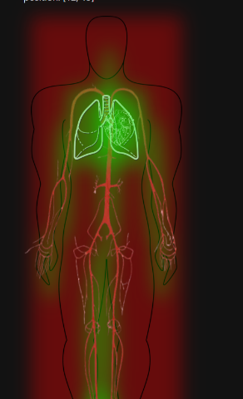
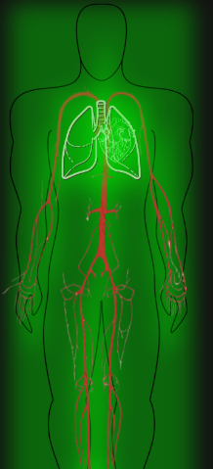
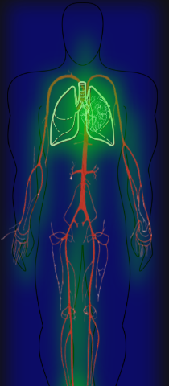
Implementation - II
Feature to search and observe a particular person in the grid and obtain their health parameters with visualization.
The human body, heart, lungs and arteries are visualized for temperature, heart rate, respiratory rate and blood pressure respectively.
The statistical information regarding the simulated pandemic is also displayed informing the number of infected, vaccinated, critically affected, etc.
Red -> Cautionary Health
Green -> Good Health
Blue -> Critical Health

Slide 9
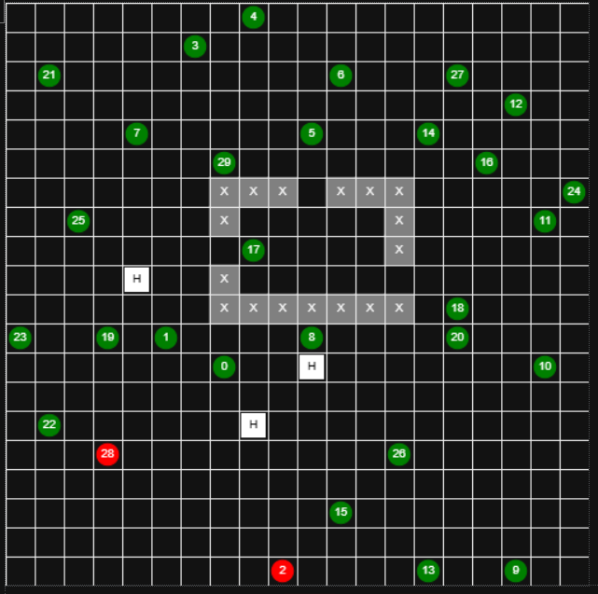
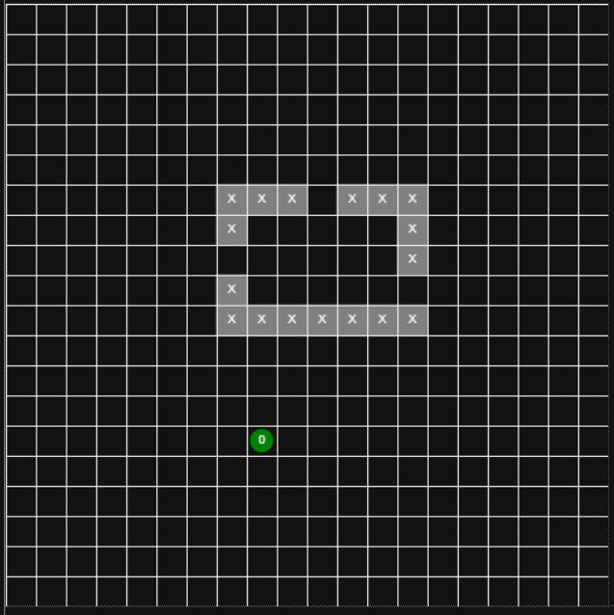
Implementation - III
The application has two modes:
Pandemic Simulation
Health Prediction
When the number of persons in the environment exceeds one, the system operates as a pandemic simulation(probabilistic). However, if only a single person is present, it functions as a health prediction model(deterministic).
This is because a person’s health parameters are affected by other persons.
Pandemic Simulation
Health Prediction

Slide 10
Limitations and Future Scope
Small time variant dataset, leading to ML models with high loss.
Inflexible Framework of Mesa. Most of the alignment of images and text were done manually including sending of the HTML components.
Currently, the environment includes only Persons, Hospitals, and Walls, with scope for adding more functionality in future iterations.
The Model needs to run a few number of steps before the simulation and health predictions are accurate.

Slide 11
Conclusion
While the implementation is simple, using Mesa with JavaScript for visualization is unconventional and less customizable compared to platforms like Azure or Siemens. However, as a free, open-source option, Mesa is practical for cost-effective digital twin development. Despite using a small, time-varying dataset that leads to higher loss, the framework remains functional and far less complex, requiring only a single backend file compared to the full APIs needed in other platforms.

Slide 12
Thank You

